Slide 1
THE OVERLOOKED RISK OF UNREGISTERED LEASES

Slide 2
Outline
Preamble
The Legal Framework: Land Act, 2012 | Land Registration Act, 2012 | Land Laws (Amendment) Act, 2016
A Risk Perspective
Conclusion

Slide 3
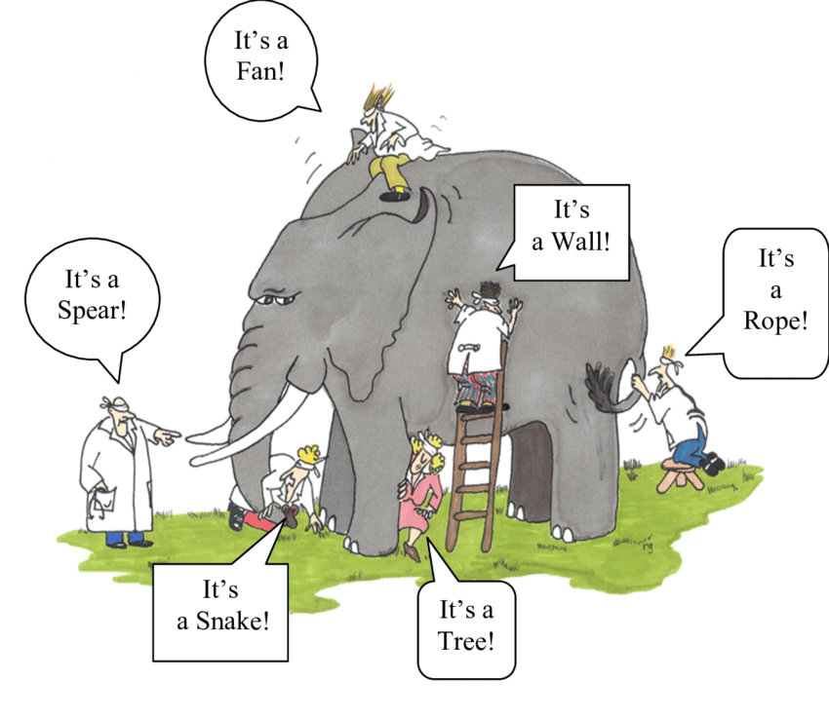
Preamble
The Blind Men and the Elephant
📸ResearchGate

Slide 4
Preamble
In context:
Each party’s perspective (tenant, advocate, landlord) may differ, leading to fragmented understanding and decision-making
The importance of registration might be overlooked or minimized because some parties perceive it as a minor administrative step, failing to recognize the long-term risks

Slide 5
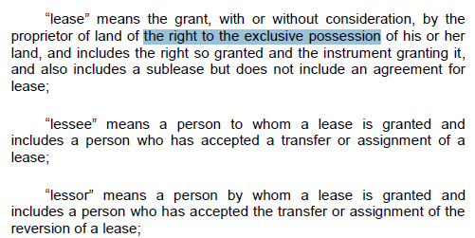
The Legal Framework
The Land Act, 2012
Section 2 – Interpretation

Slide 6
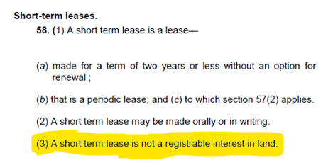
The Legal Framework
The Land Act, 2012
Section 58(3) – Leases that require registration

Slide 7
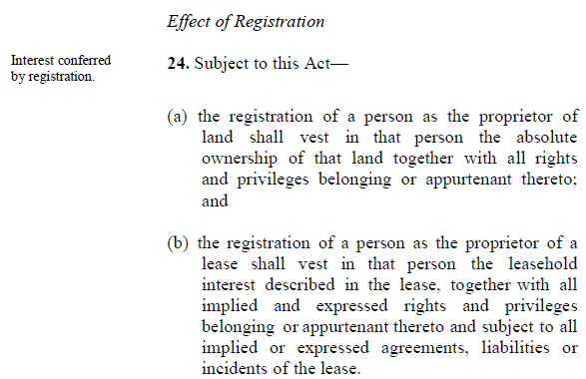
The Legal Framework
The Land Registration Act, 2012
Section 24 – Establishes the legal significance of registering an interest in land. It differs from the “disposition of a lease” under section 32 which includes an assignment, sublease, surrender, novation, or variation

Slide 8
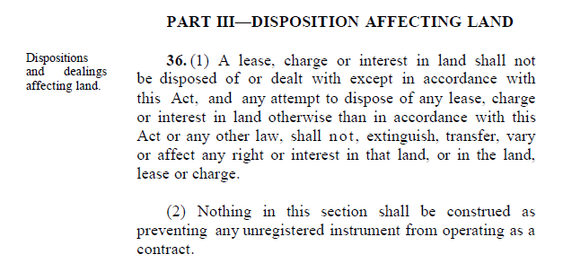
The Legal Framework
The Land Registration Act, 2012
Section 36(2) – Clarifies that an unregistered lease can still operate as a contract

Slide 9
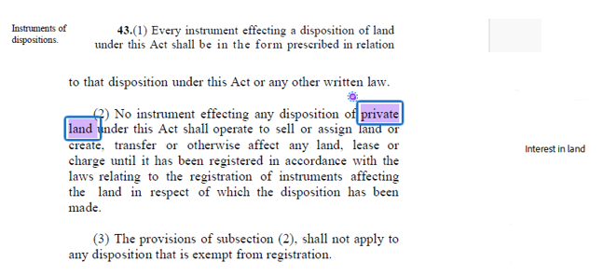
The Legal Framework
The Land Registration Act, 2012
Section 43(2) – Creating a valid lease interest against property

Slide 10
What is a commercial lease?
A commercial lease is a legally binding agreement between a lessor (landlord) and a lessee (tenant) that grants the tenant the right to occupy and use a specified property for commercial purposes, such as operating a business, providing services, or carrying out trade, in exchange for rent and other obligations outlined in the lease agreement
Types of Commercial Leases
1. Office Leases: Spaces rented for administrative or corporate activities
2. Retail Leases: Premises used for retail businesses, including malls and shops
3. Industrial Leases: Warehouses, factories, or manufacturing facilities
4. Mixed-Use Leases: Properties that combine commercial and other uses, such as
a horticulture lease which generally fits under agricultural use but activities on the
land may extend to commercial purposes, such as packaging or processing
Considerations for these tenants include prime location, customer traffic, location-specific infrastructure therefore security of tenure is supreme. Industrial tenants such as factories or warehouses, often require significant capital investments in equipment and infrastructure and would need to cushion against exposure to significant financial losses

Slide 11
A Risk Perspective
Third-party situations that can affect an unregistered registerable leases
Sale of property: If the landlord sells the property, the new owner is not bound by an unregistered lease unless they specifically agree to honour it
Creation of charges: If a landlord creates a charge over the property, the financier's rights may take precedence over an unregistered lease
Landlord's insolvency: If a landlord becomes insolvent, an unregistered lease may not be recognized as a protected interest, leaving the tenant exposed
Landlord's death: A tenant's long-term planning and investments can be jeopardized by succession issues
Change of user: Lack of registration can leave a tenant vulnerable to changes in how the property is used, which could conflict with the intended permitted use or even disrupt the tenant's operations
Loss of priority during government-imposed directives: If the property is undergoing administration processes such as the ongoing land conversion and migration, a tenant's interests can be overlooked during these processes.

Slide 12
Conclusion
Consider all parts of the elephant
Understand the risk landscape of unregistered leases
Best practices to avoid negligence claims

Slide 13
THANK YOU!

