Slide 1
STRUCTURING SECTIONAL TITLES
UNDERSTANDING THE CONCEPTS

Slide 2
Outline
Introduction
Key concepts
Surveyor’s insights
Q&A
TAX AND EXCHANGE CONTROL
Notes:
Where to find precents can be discussed by the Kenyan office and South African office – 1 minute each.

Slide 3
Introduction
Sectional titles were originally introduced into Kenyan law by the Sectional Properties Act, 1987. This Act was subsequently repealed and re-enacted, with various amendments in 2020 as the Sectional Properties Act, 2020. The 2020 Act is further supported by detailed Regulations that were published in 2021.
Sectional titles are a step toward accommodating urban growth, providing a solution for urban housing challenges. Establishment of this regime was also intended to promote consistency and predictability in the sectional titles regime.
Historically conceptualized to enable vertical subdivision of land but quickly extended to horizontal subdivisions variously called ‘cluster’, ‘group’ or ‘community’, ‘precincts’ titles [for master planned estates].

Slide 4
Key concepts | Understanding terminology
Building: Means one or more structures on the same parcel built either vertically (one unit on top of another) and horizontally (where the units are side by side) and includes apartments, flats, maisonettes, townhouses, offices and warehouses.
Sectional unit: A “unit” is defined as a space that is situated within a Building and described in a sectional plan by reference to floors, walls and ceilings within the building, and includes its proportionate share in the common parts of the property.
Tenancy in common: A legal arrangement that allows two or more parties to own distinct undivided shares in the property, with no right of survivorship.
Common property: Comprises every part of the land in a sectional title development plus the buildings or parts of buildings in the development which have not been included in the sections delineated on the sectional plan. It is owned by all the unit owners as tenants in common and is available for use by all members of the development, subject to the by-laws and/or the controls exercised by the corporation.

Slide 5
Key concepts – Understanding terminology
Sectional plan: Means a georeferenced plan of units or a part of land, as the case may be, prepared by a surveyor and approved by the statutory body responsible for survey of land.
Every plan presented for registration as a sectional plan must be georeferenced. Georeferencing is the process of taking a digital image and adding geographic information to the image so that GIS or mapping software can 'place' the image in its appropriate real-world location.
The process of preparing a sectional plan includes field survey, site/location plan preparation, sectional plans plotting, procuring endorsements by owner/surveyor/county government, authentication of the sectional plan at the Survey Records Office and registration of the sectional plan at the Land Registry.
A Registrar shall not register a sectional plan unless the sectional plan describes two or more units in it.

Slide 6
Key concepts | Corporation
A body corporate is constituted under section 17 of the Act, to supervise the common areas of the development. It functions as a legal entity that represents the collective interests of the unit owners.
The provisions of the Companies Act, 2015 do not apply to the Corporation. Unit owners typically do not receive share certificates in the same way they would in traditional management company structure.
The stakeholders of the corporation are the owners of the unit. On the first registration, the by-laws specified in the Regulations shall be the by-laws of the Corporation. By-laws can be amended, repealed or replaced by a special resolution, taking effect once the Corporation has filed a copy of it with the Registrar, and the Registrar has made a memorandum of the filing on the sectional plan.
Disputes may arise among the unit owners, and this is resolved using the corporation by-laws. However, serious violations are submitted to the Dispute Resolution Committee

Slide 7
Key concepts | Exemptions and exclusions
Exclusion: | The 2020 Act explicitly states that it applies only to land held on freehold title or on a leasehold title where the unexpired residue of the term is not less than 21 years and there is an intention to confer ownership.
Exemption: | The Regulations provide exemptions for specific categories of long-term leases: Where the reversionary interest is expressly retained by the developer, lessor, or management company as legal owner (and not as trustee). Large mixed-use developments and phased developments, where it is agreed that the developer or management company will retain the reversionary interest. Projects of strategic national importance, substantial transactions, and special economic zones, where relinquishing the reversionary interest is deemed impractical.
Reversionary interest: | When long-term leases are used in certain developments instead of sectional title ownership, and the developer or management company retains the reversionary interest. In such cases: The purchaser does not own the property outright but holds it under a long-term lease, after which the ownership could revert to the developer or a management entity on expiry of the lease. This can create a situation where the transaction feels like an ownership arrangement but legally functions as a lease without transfer of reversionary interest, so there is no permanent ownership.

Slide 8
Key concepts | Permitted use
Land use considerations are pivotal when preparing sectional titles. Properties originally zoned for single-dwelling, hotel or institutional use (by way of example) require a formal rezoning permitting multi-units, so there will be a multi-step process that involves change of use aligning the use with densification. Recommended to consult your physical planner.
Checking the possible effects of rezoning on neighbors and the surrounding area, such as increased traffic or infrastructure strain—basically, community impact—is one of the key components of environmental impact assessment. For this reason, public participation is typically required.

Slide 9
Key concepts | Unit factor
A unit factor is the representation of shares per unit owner in relation to common property. They are much like ‘shares’ in a company but the company in this case is the sectional title development.
There is a specific formula used to compute unit factors. The allocation of unit factors typically considers (1) the floor area of the unit including areas which may be part of the sectional title unit such as balconies and parking bays, and (2) the value of the unit in relation to others in the development – this can be determined based on market value or other valuation criteria.
It is important to note that while the unit factor governs rights and obligations related to the common property (including voting power and liability for contributions to the operating expenses of the development), it does not translate into direct ownership of specific parts of the common property, but rather a share interest in it with other unit owners.
In a multi-unit sectional title development where a unit is purchased together with a parking bay, it is important to consider the classification of the parking bay and the allocation of unit factors.

Slide 10
Key concepts | Exclusive use areas
An exclusive use area is a part of common property of a sectional title development which has been reserved for the use of a particular owner to the exclusion of the others in the development.
s40. A Corporation, by a unanimous resolution, may, if its by-laws permit, grant a lease to an owner of a unit permitting that owner to exercise exclusive use in respect of an area or areas of the common property.
"Unanimous resolution" means a resolution —passed unanimously at a properly convened meeting of the Corporation by all the persons entitled to exercise the voting powers conferred by the Act or the by-laws and representing the total units.
Food for thought: Is it possible for government to compulsorily acquire common property that is not designated as an exclusive use area?

Slide 11
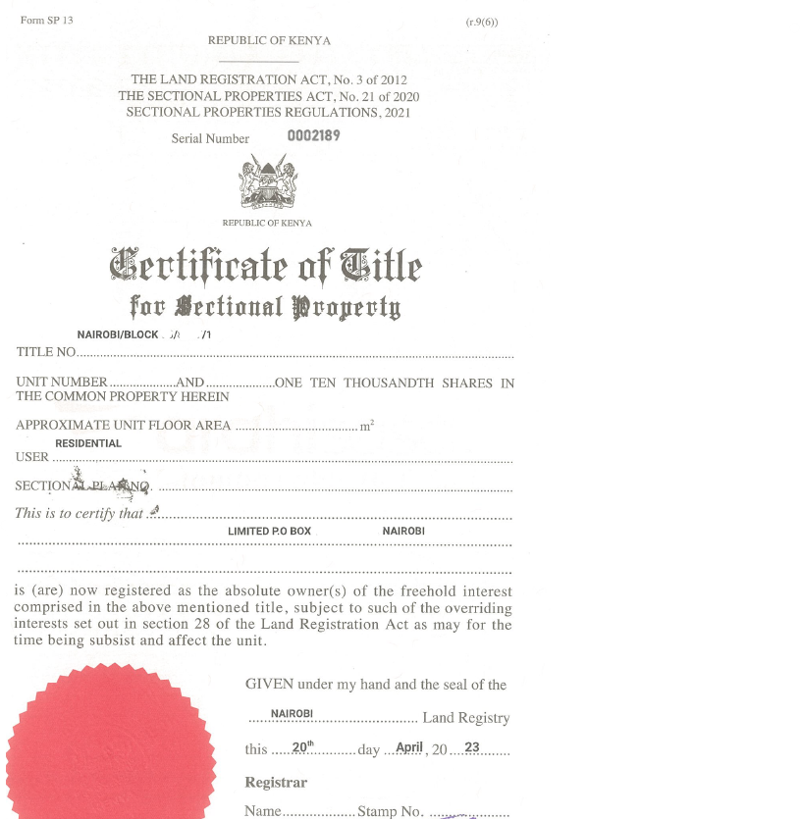
Key concepts | Sectional titles and freehold
Traditionally, freehold ownership was associated with standalone properties where the owner had complete control over the land and any structures on it, with minimal external restrictions. This model was well-suited to individual houses or estates where there are no shared facilities or common areas. With the advent of multi-unit developments such as apartments and gated communities, the concept of freehold ownership has had to evolve, leading to the integration if freehold ownership within a framework that includes by-laws for management of the common property.

Slide 12
Key concepts | Multi-layered completion
Georeferencing is carried out after construction is finished therefore it is an "as-built" survey.
Currently, the order of events is as follows: Construction completion, post-construction georeferencing, sectional plan preparation, sectional title processing, and completion.
This introduces the need for ultimate certainty regarding the completion of transactions. Over and above the projected construction completion date, when the building is expected to be handed over to the developer, there should be a fixed date providing a clear target and deadline for completion, being the date when the developer expects to be in possession of the sectional titles following georeferencing.

Slide 13
Key concepts | Section 43 of the 2020 Act
s43(1), A developer shall not sell or agree to sell a unit or proposed unit unless the developer has delivered to a purchaser a copy of — (a) the purchase agreement; (b) the by-laws or proposed by-laws; (c) the management agreement or proposed management agreement, if any; (d) the recreational agreement or proposed recreational agreement, if any; (e) the lease or title of the parcel on which the unit is located or the certificate of title or the certificate of lease in respect of the unit; (f) any charge that affects or proposed charge that will affect the title to the unit or proposed unit or, in respect of that charge or proposed charge a notice prescribed under subsection (2); and (g) the sectional plan or proposed sectional plan.
s43(2), A developer shall deliver to the purchaser in respect of a charge or proposed charge a written notice stating — (a) the maximum principal amount available under the charge; (b) the maximum monthly payment that may be paid under the charge; (c) the amortization period; (d) the term; (e) the interest rate or the formula, if any, for determining the interest rate; and (f) the prepayment privileges, if any.
Note: There is still a learning curve when it comes to embracing the dynamics of off-plan transactions where units are sold before construction is complete. The legal and regulatory framework has not fully adapted to this, particularly in light of the following requirements under the 2020 Act.

Slide 14
Sectional titles and planned / mixed-use developments
Developers play a crucial role in creation of planned developments. The essence of planned developments lies in its comprehensive design and execution to create a cohesive, functional and sustainable environment, with a holistic approach integrating various land uses (residential, commercial, recreational, industrial) into a single, well-organized layout. Developments within these organized zones are usually executed in phases.
If you apply the concept of sectional titles in such developments you may essentially be introducing fragmented ownership, where multiple owners hold separate titles. Many developers have voiced their concern that this can lead to inefficiencies in managing the common areas, delays in decision-making, and misaligned priorities among stakeholders AND this can ultimately affect the cohesiveness and functionality of the entire development.

Slide 15
Surveyor’s insights
TAX AND EXCHANGE CONTROL
Notes:
Where to find precents can be discussed by the Kenyan office and South African office – 1 minute each.

Slide 16
QN - 1
Could you please provide insight into how one can effectively carry out due diligence on sectional plans – how can one verify the integrity and authenticity of sectional plans?

Slide 17
QN - 2
In terms of timelines, how long does georeferencing typically take for development of a sectional plan, and what are the key approvals required at different stages of the process? Also consider:
Whether the size of the development impacts the process, and if so, what developers should keep in mind when designing larger developments.
Whether there is a distinction between georeferencing on a vertical scale versus a horizontal scale, and how each impacts the planning and approval process.

Slide 18
QN - 3
How do you allocate unit factors when preparing sectional plans? In addition, can you explain how parking bays, storage areas, and other exclusive use areas are reflected in sectional plans?

Slide 19
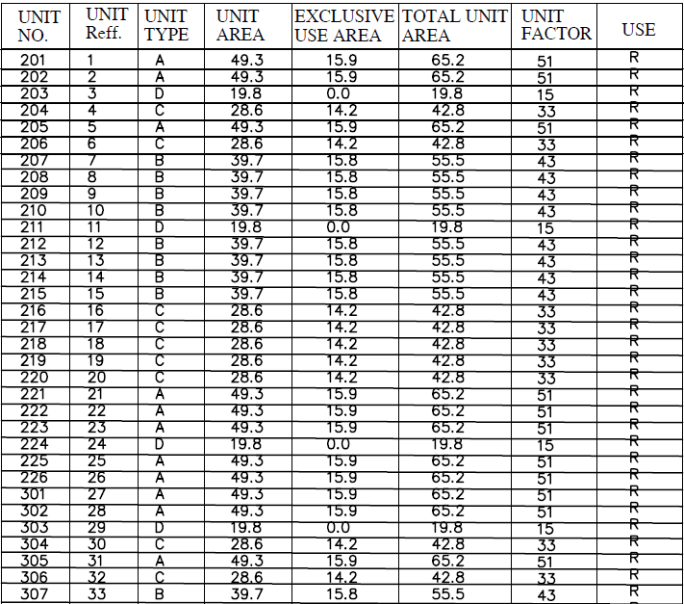
QN - 3

Slide 20
QN - 4
What are the most common errors you encounter when developers submit sectional plans for approval, and how can these be avoided?

Slide 21
QN - 5
What are the most common causes of delays in processing sectional titles, and how can developers mitigate these delays?

Slide 22
Thank You!
For Your Attention

